Slide 1
Tecky WSP Project
Tecky Online Snack Bar
C23 TW Group 2
Kenneth Chan
Eric Lam
Terence Wong

Slide 2
Outline
Landing Page (Terence)
Login / Logout (Kenneth)
Edit Profile / Change Password (Kenneth)
Search Bar / Search Page (Kenneth)
Register Page (Eric)
All Products Page (Terence)
Single Product Page (Eric)
Shopping Cart Page (Eric)
Payment Page (Terence)

Slide 3
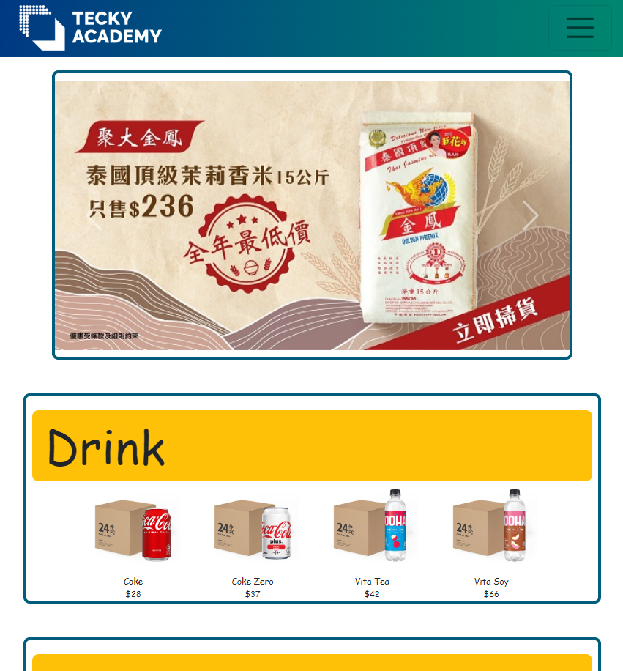
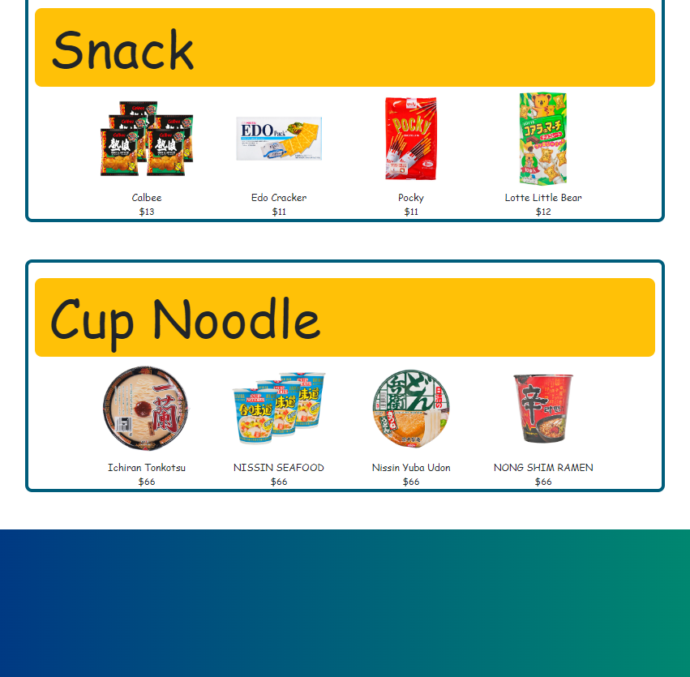
Landing Page (Terence)
With Tecky Logo
2
Carousel display advertisement
2
Display “Top-sales” products
Method : GET
Sequencing by the sales quantity of products

Slide 4
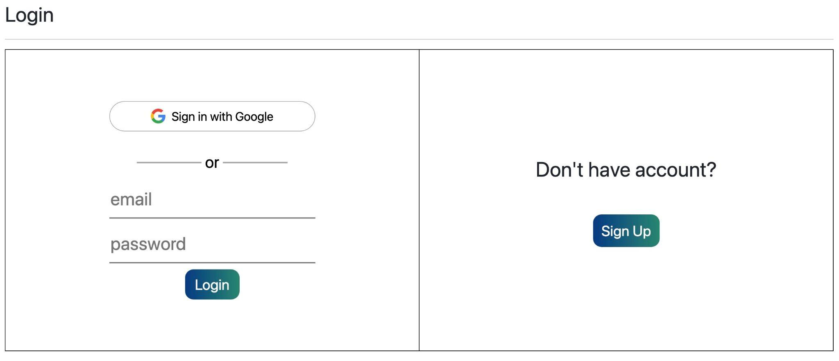
Login / Logout (Kenneth)
Two methods to login
Google Login (Google Oauth 2.0)
Email Login (Validate with PostgreSQL Database)
No account → Sign Up Button → Register.html

Slide 5
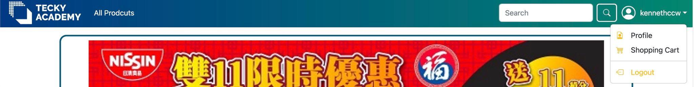
Login / Logout (Kenneth)
Before Login → After Login → After Logout
Login Button → User Icon with Username → Back to Login Button
/user/index.css (Guarded with guardMiddleware)

Slide 6
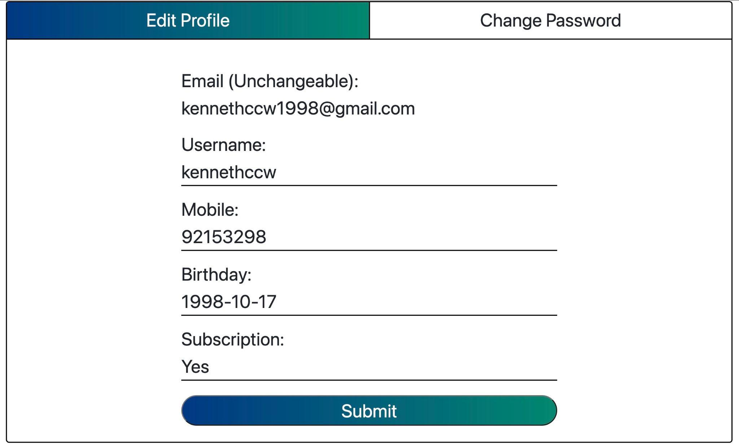
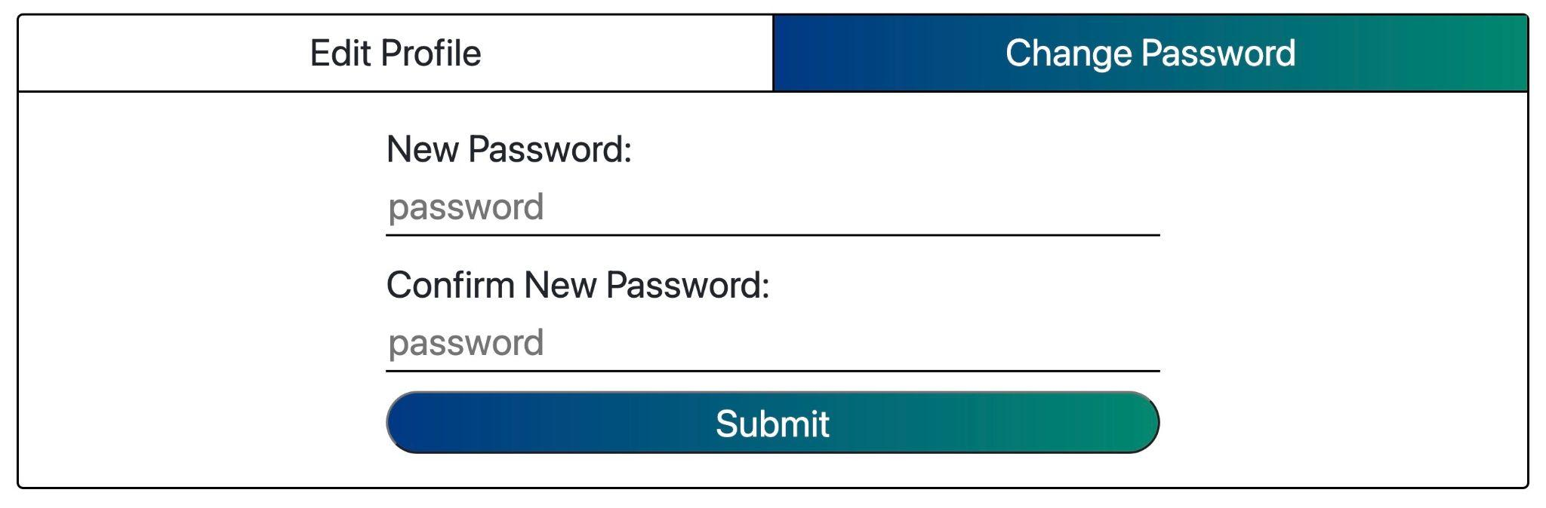
Edit Profile / Change Password (Kenneth)
User’s Information (PostgreSQL Database)
“PUT” method + contenteditable
→ Update Data in PostgreSQL Database
Change Password
“PUT” method + form submission
→ Update Password in PostgreSQL Database
(Hashed Format)

Slide 7
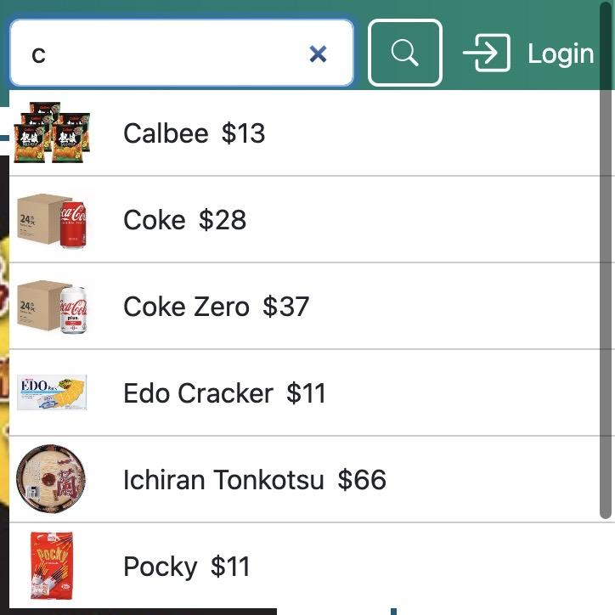
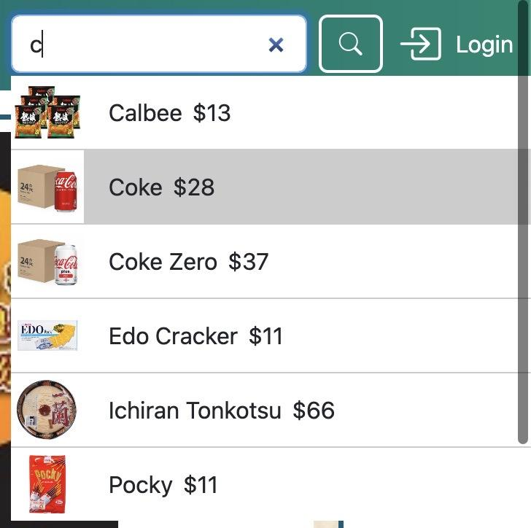
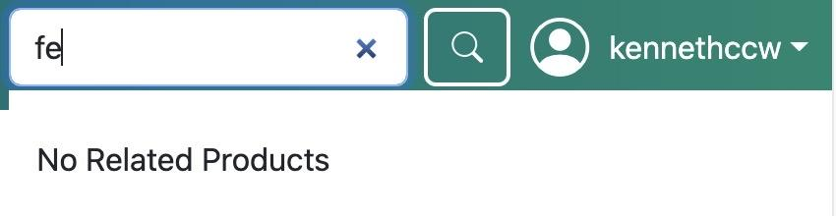
Search Bar / Search Page (Kenneth)
eventListener (“input”)
→ “POST” method
→ %<input>% (query)
eventListener (“click”)
→ window.location = “/product.html?id=<product id>”
Query Not Match
→ “No related Products”

Slide 8
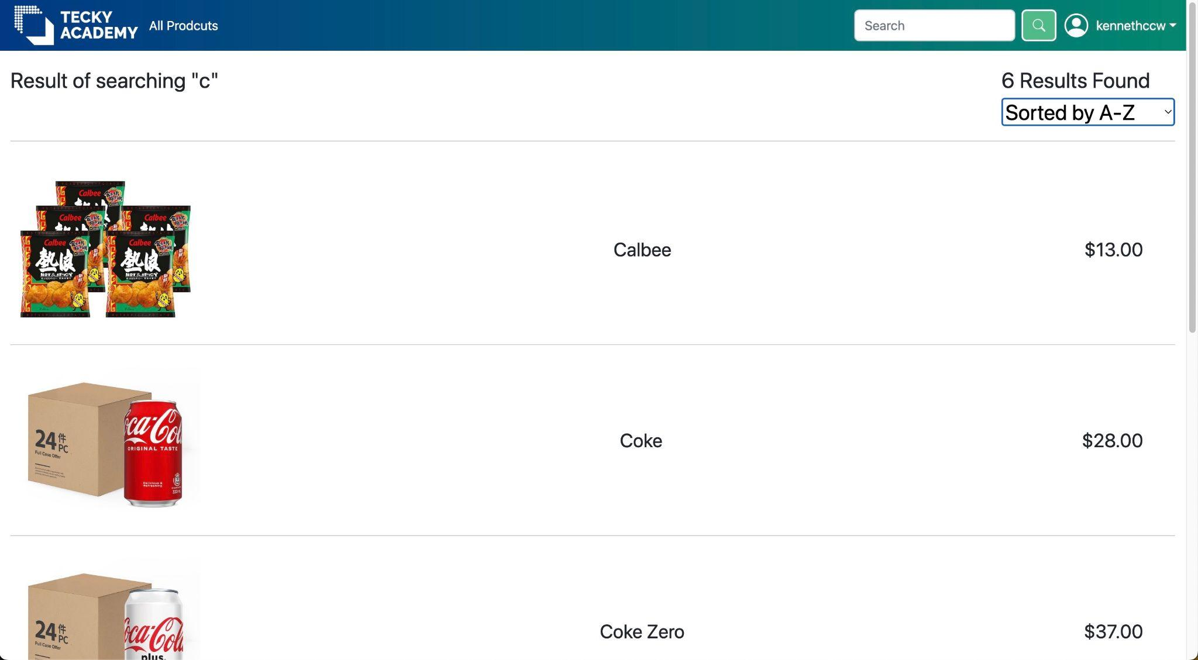
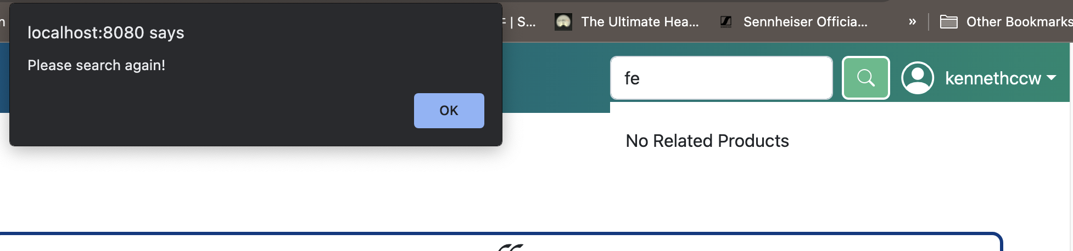
Search Bar / Search Page (Kenneth)
eventListener (“submit”)
→ window.location = “/searchProduct.html”
Failed → alert

Slide 9
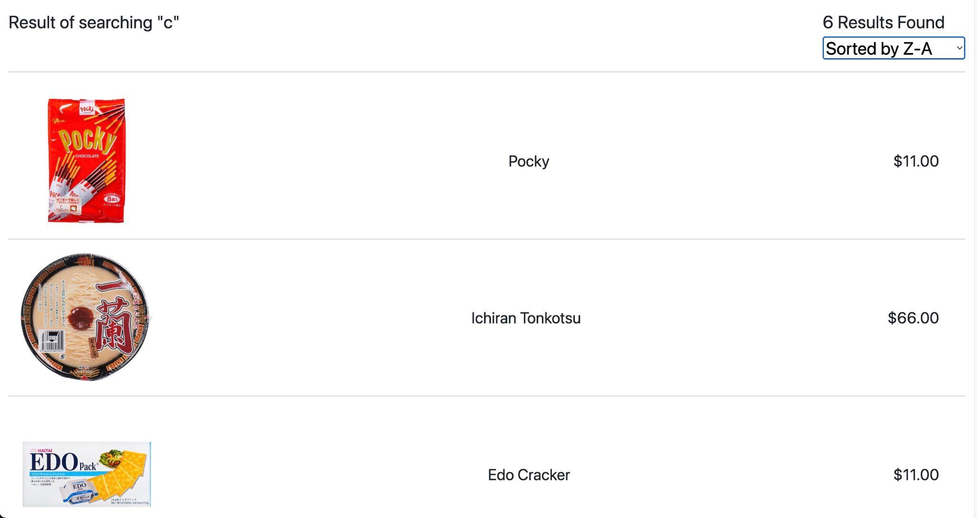
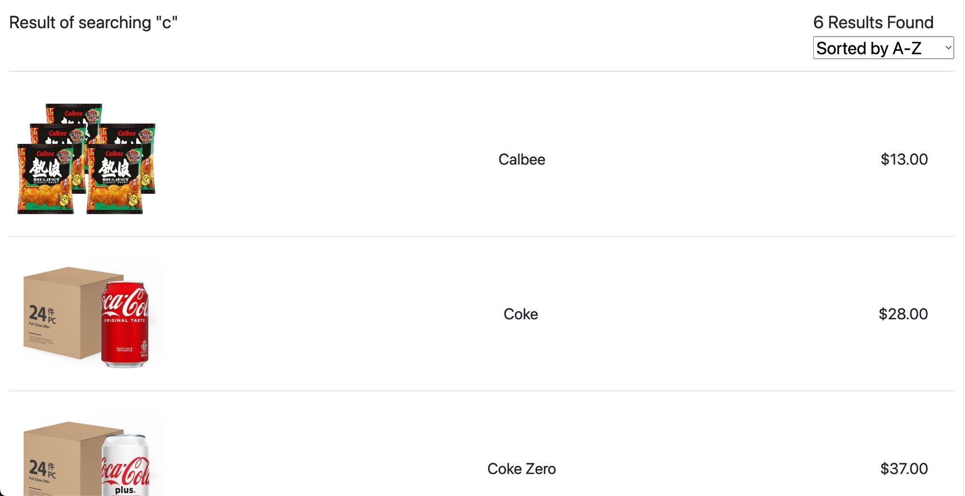
Search Bar / Search Page (Kenneth)
eventListener (“change”)
→ “GET” method → “/sort/?alphabet=asc” || “/sort/?alphabet=desc”
(Sorted According to Alphabetical Order with PostgreSQL)

Slide 10
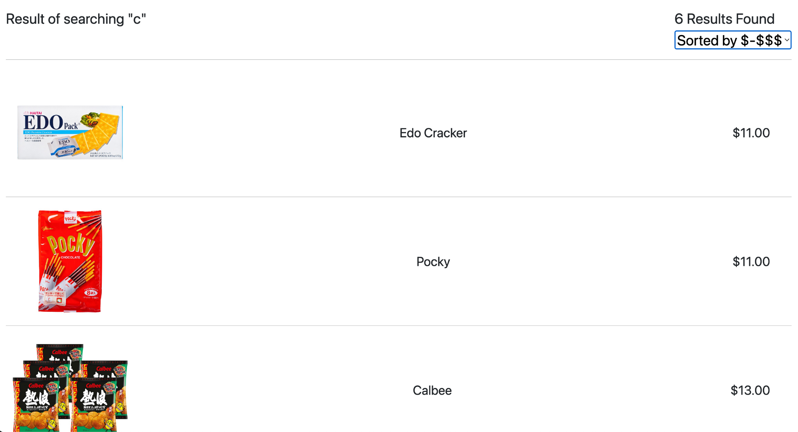
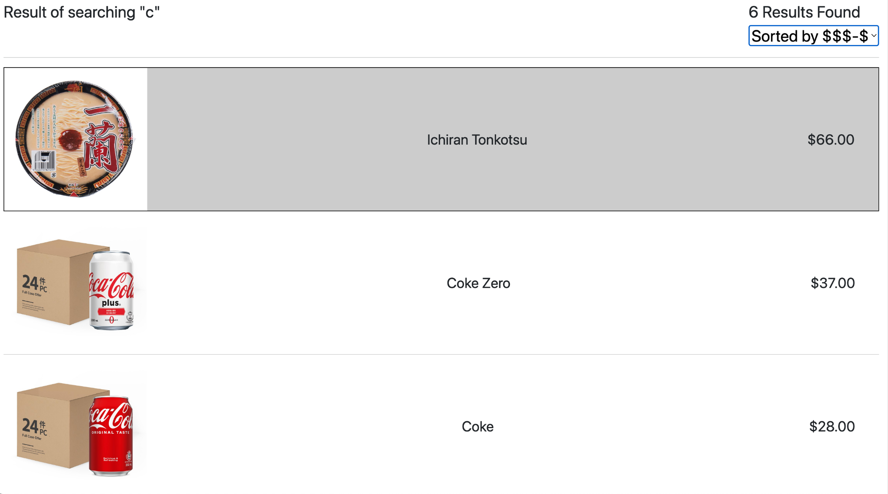
Search Bar / Search Page (Kenneth)
eventListener (“change”)
→ “GET” method → “/sort/?price=asc” || “/sort/?price=desc”
(Sorted According to Price with PostgreSQL)

Slide 11
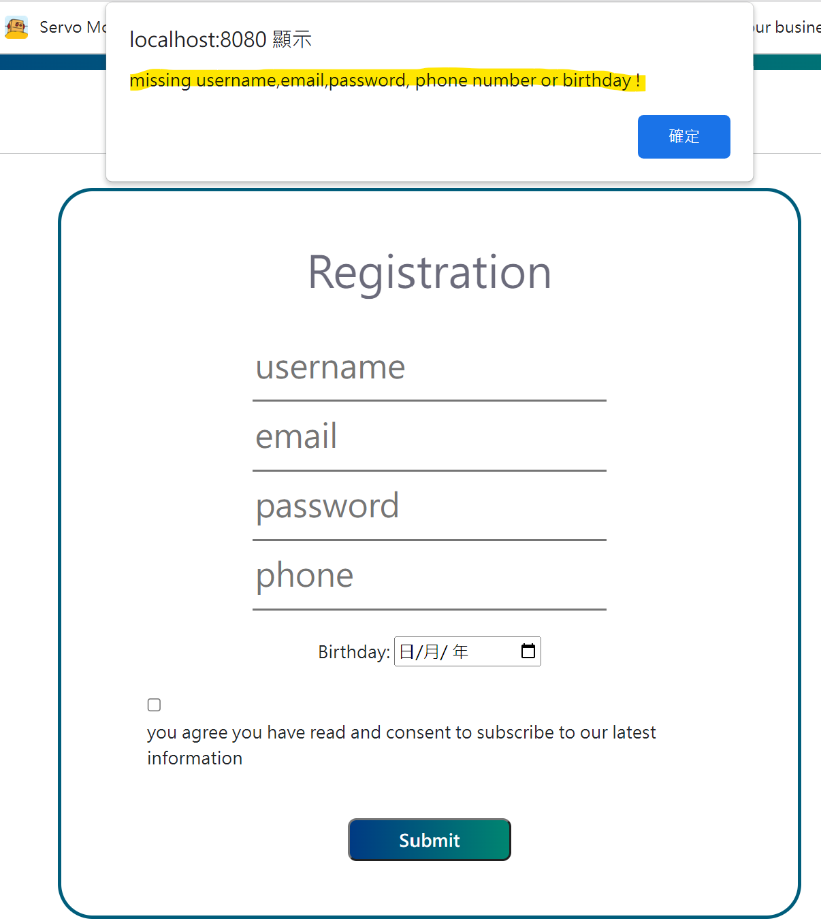
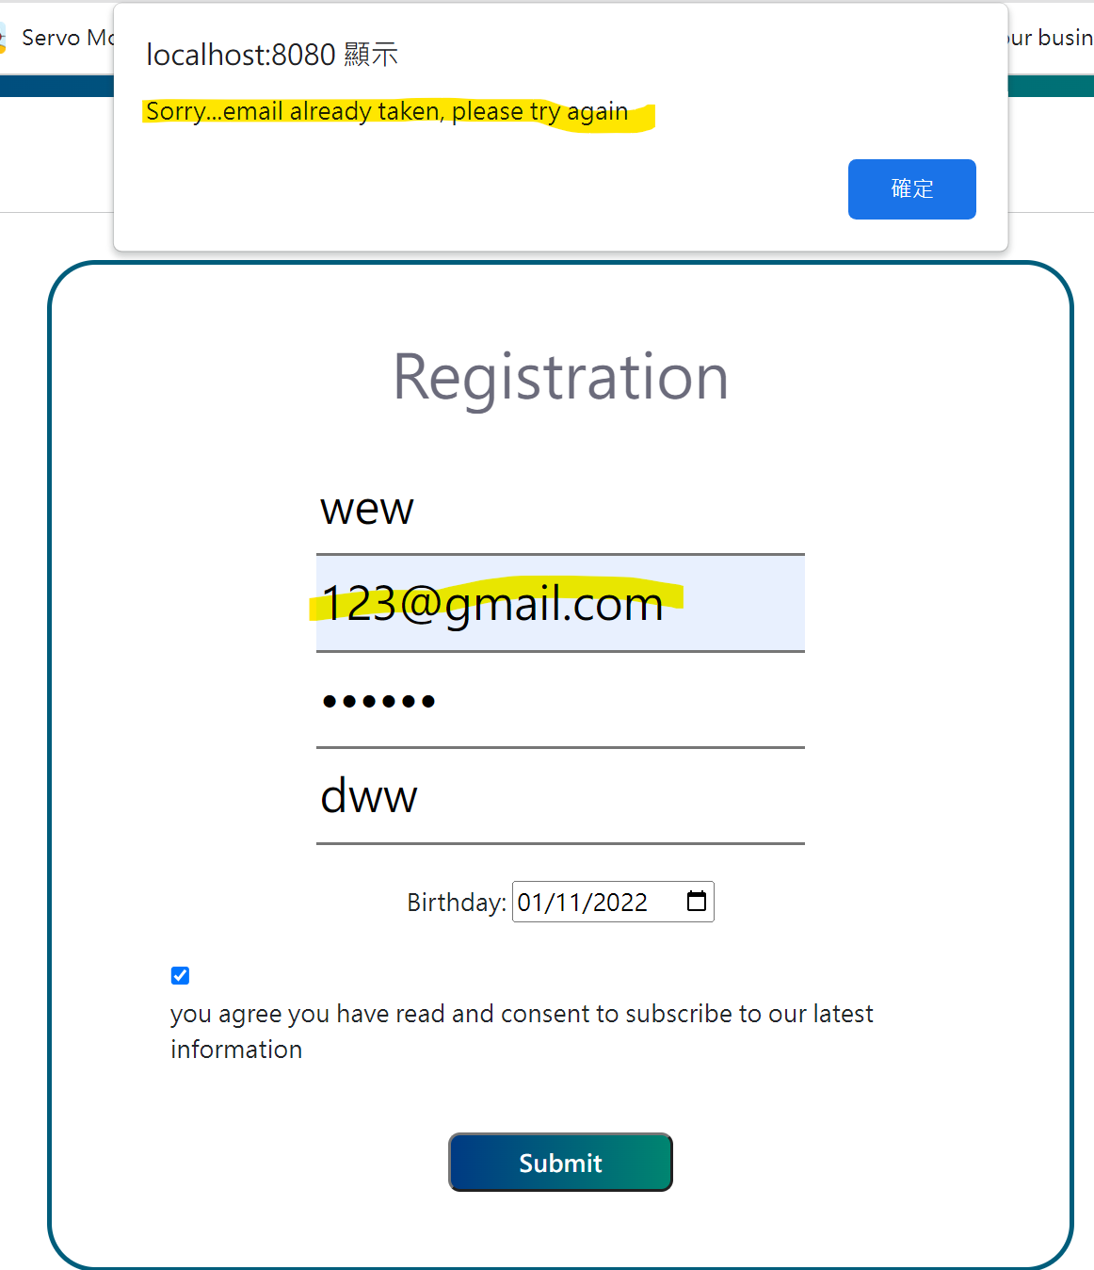
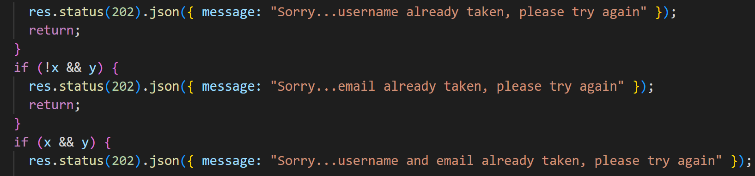
Register Page (Eric)
Same username is NOT allowed
Same email is NOT allowed
All information should be provided to register an account

Slide 12
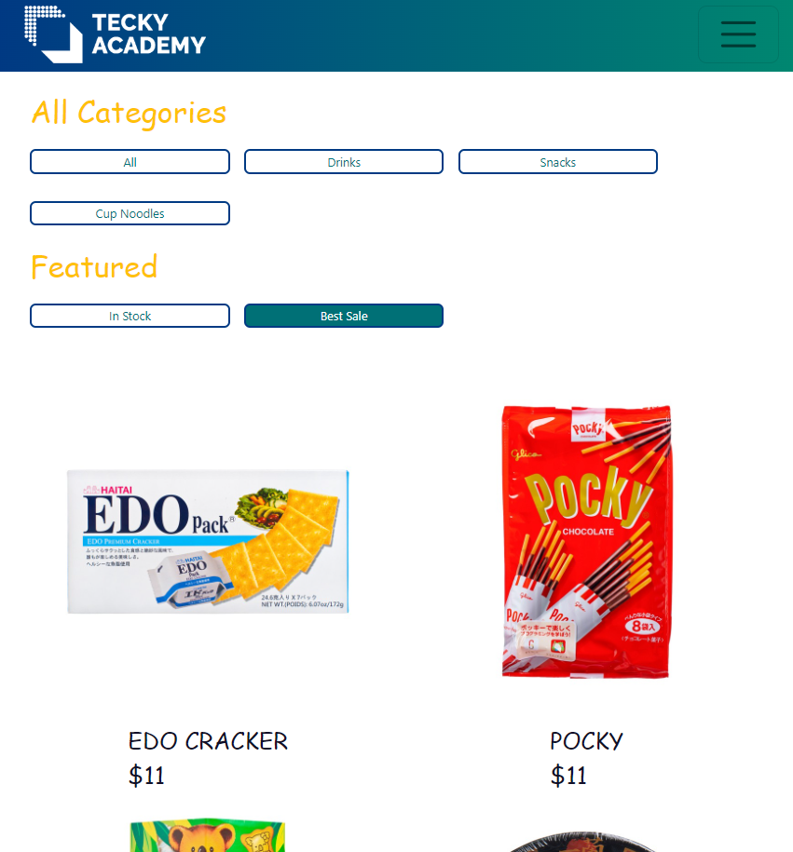
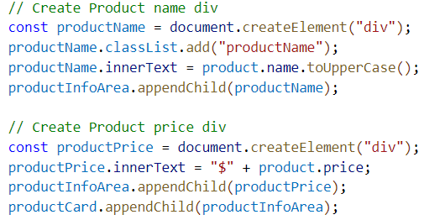
All Products Page (Terence)
Customers can have products filtration in this page
Use appendChild() to put different data together
Use class=”hide” to control the display of product
→ “hide” = display: none in css

Slide 13
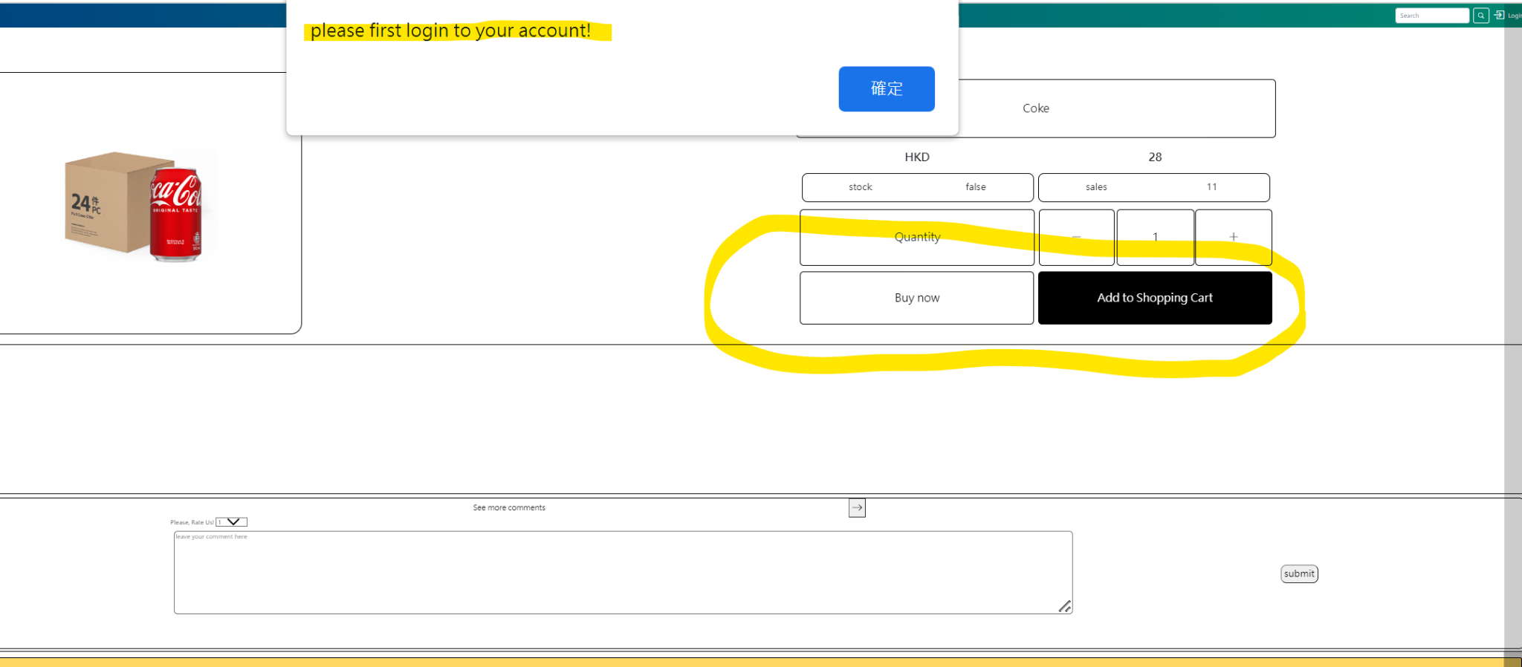
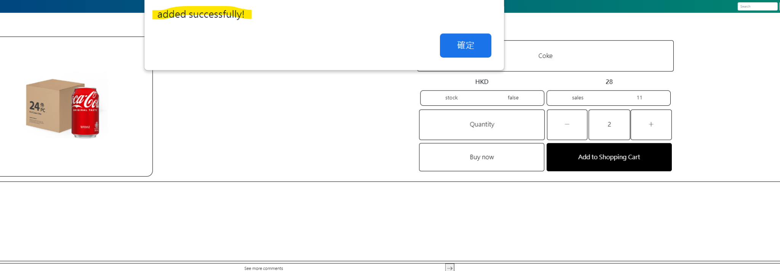
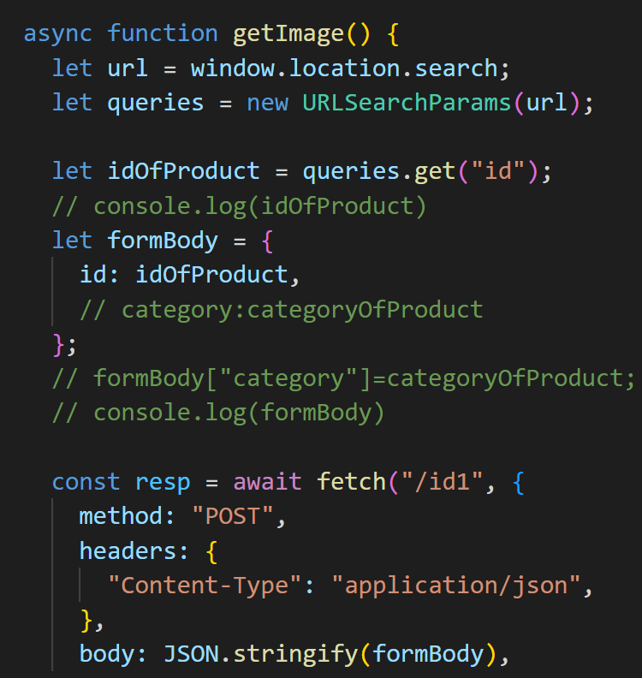
Single Product Page (Eric)
if not logged in yet, an alert will pop up
after logged in, a “successful” reminder
will pop up

Slide 14
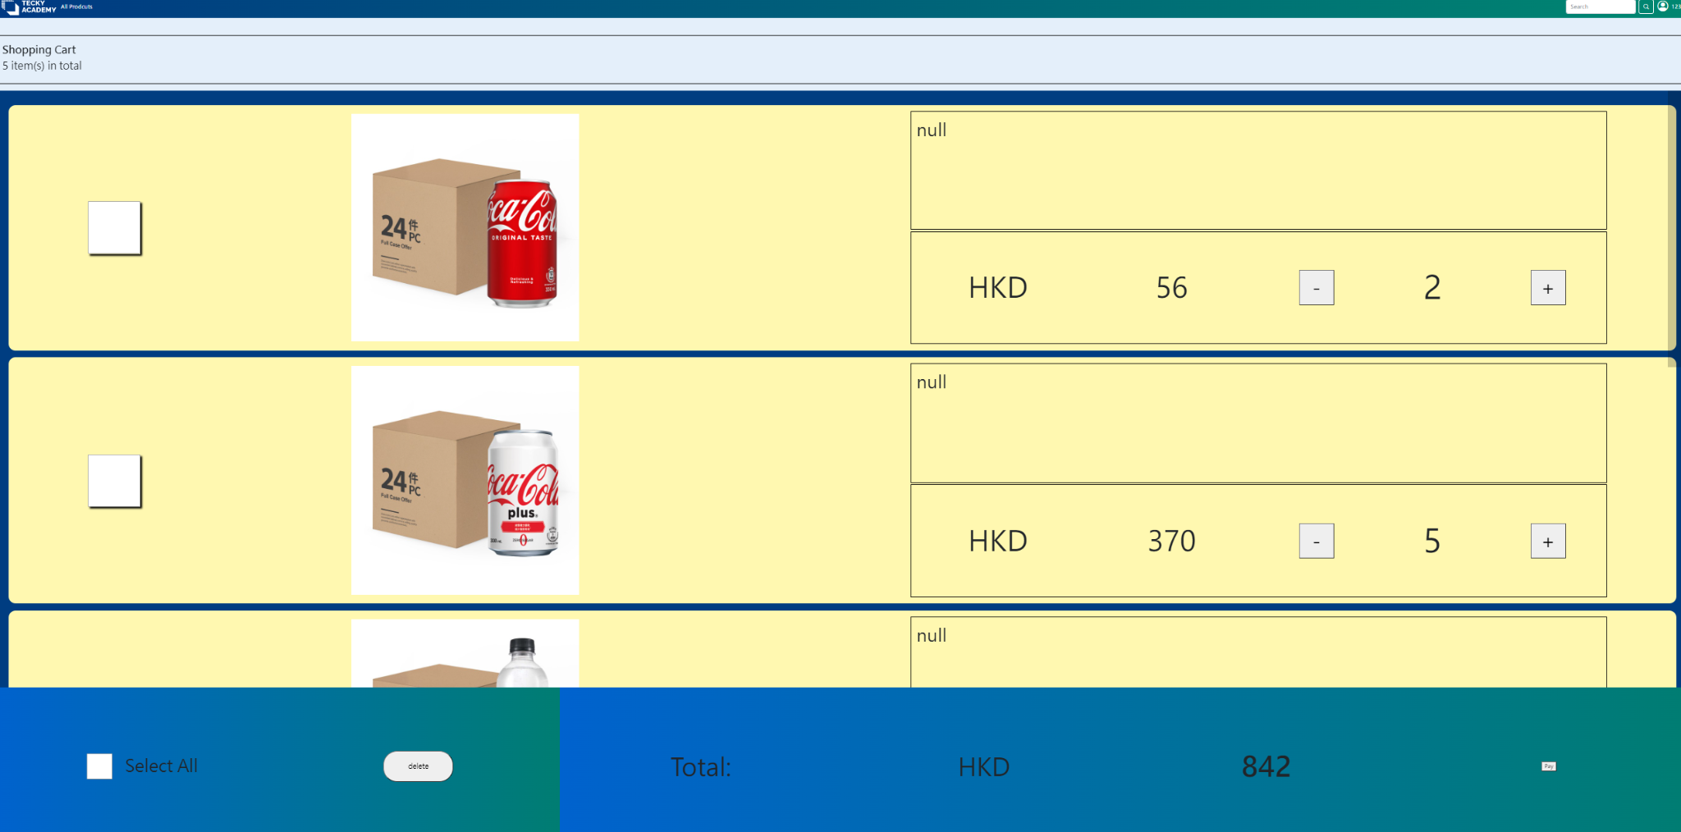
Shopping Cart Page (Eric)
users can again change their purchase decision on this page
number of items chosen shown
total amount to pay shown

Slide 15
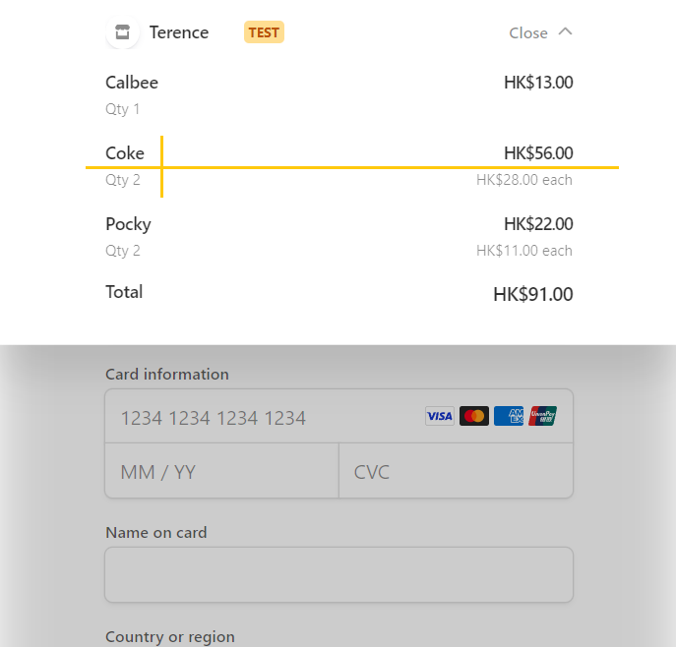
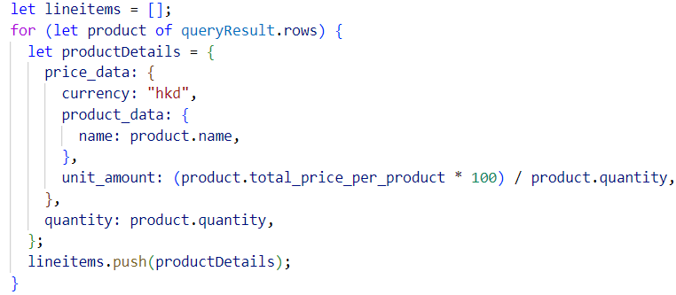
Payment Page (Terence)
Payment System with Stripe API
Method : Post
Pick up user ID & products info. from session & database
Put data into stripe format
Send info. to stripe
Use window.location to redirect to
Stripe’s url
https://stripe.com/docs/checkout/quickstart

Slide 16
Thank you

